Slide 1
Learning Objective
I will be able to graph exponential functions
Success Criteria
At the end of the lesson, I will be able to:
Graph exponential functions
Graph transformations of exponential functions

Slide 2
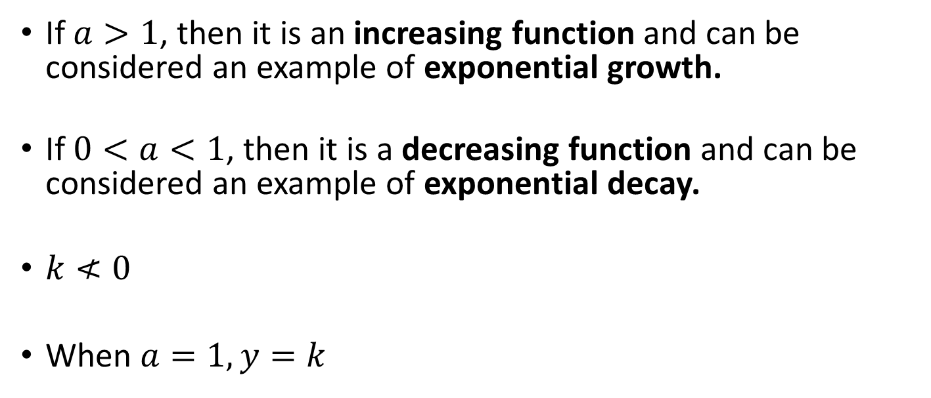

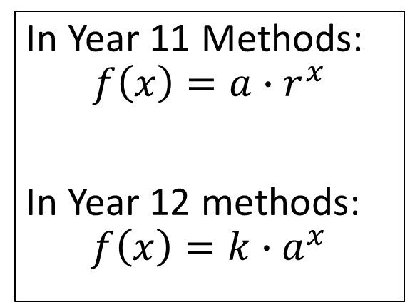
The exponential Function: $f(x)=k∙a^{x}$
Activating Prior Knowledge
In Year 11 Methods:
$$f\left(x\right)=a∙r^{x}$$
In Year 12 methods:
$$f\left(x\right)=k∙a^{x}$$
If $a>1$, then it is an increasing function and can be considered an example of exponential growth.
If $0<a<1$, then it is a decreasing function and can be considered an example of exponential decay.
$k≮0$
When $a=1, y=k$

Slide 3
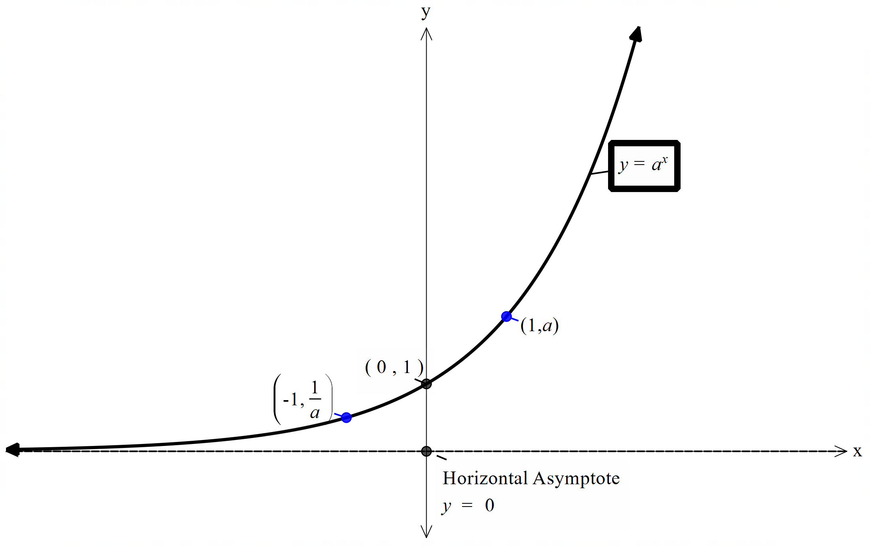


Exponential Function
$$f\left(x\right)= a^{x}, a>1$$
The y – intercept is always (0, 1)
The $y$ value is always greater than 1
When $x=1$, $y=a$
When $x=−1$, $y=\frac{1}{a}$
$y=0$ is always the horizontal asymptote
$a≠0$
As $x→∞$, $y→∞$
As $x→−∞$, $y→0$
Strictly increasing

Slide 4
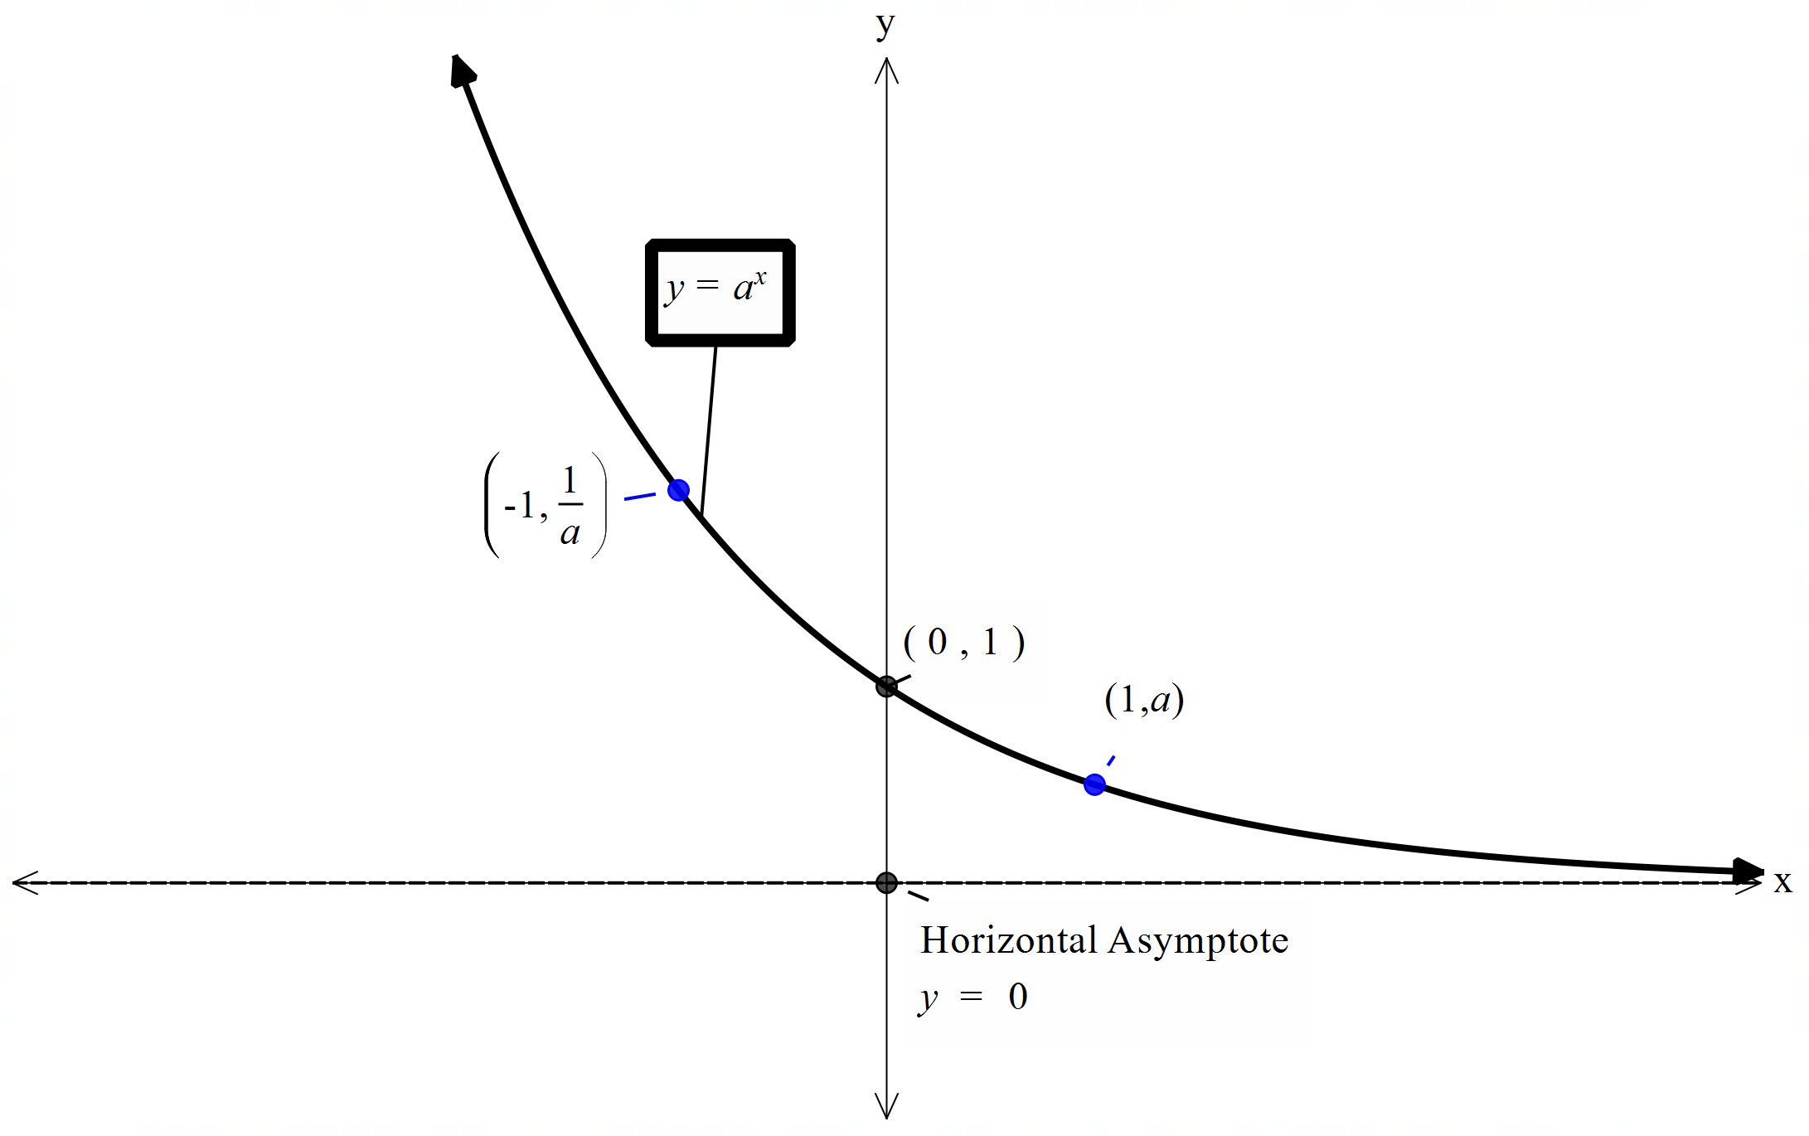


Exponential Function
$$f\left(x\right)= a^{x}, 0<a<1$$
The y – intercept is always (0, 1)
The $y$ value is always greater than 1
When $x=1$, $y=a$
When $x=−1$, $y=\frac{1}{a}$
$y=0$ is always the horizontal asymptote
$a≠0$
As $x→∞$, $y→0$
As $x→−∞$, $y→∞$
Strictly decreasing

Slide 5
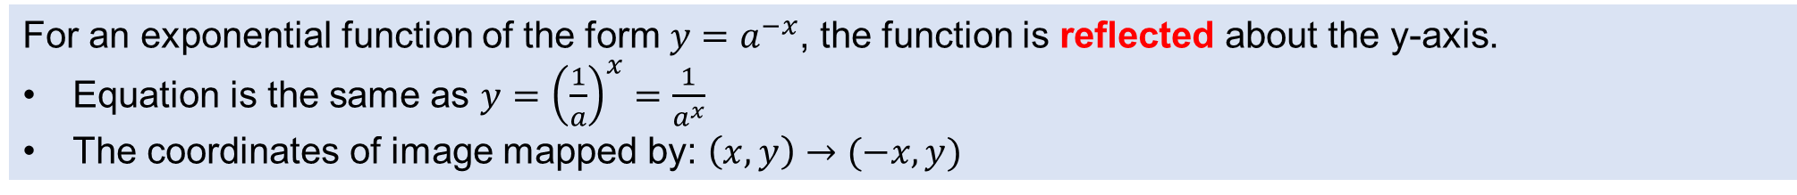
Activating Prior Knowledge - Reflection
For an exponential function of the form $y=a^{−x}$, the function is reflected about the y-axis.
Equation is the same as $y={\left(\frac{1}{a}\right)}^{x}=\frac{1}{a^{x}}$
The coordinates of image mapped by: $\left(x,y\right)→(−x,y)$

Slide 6
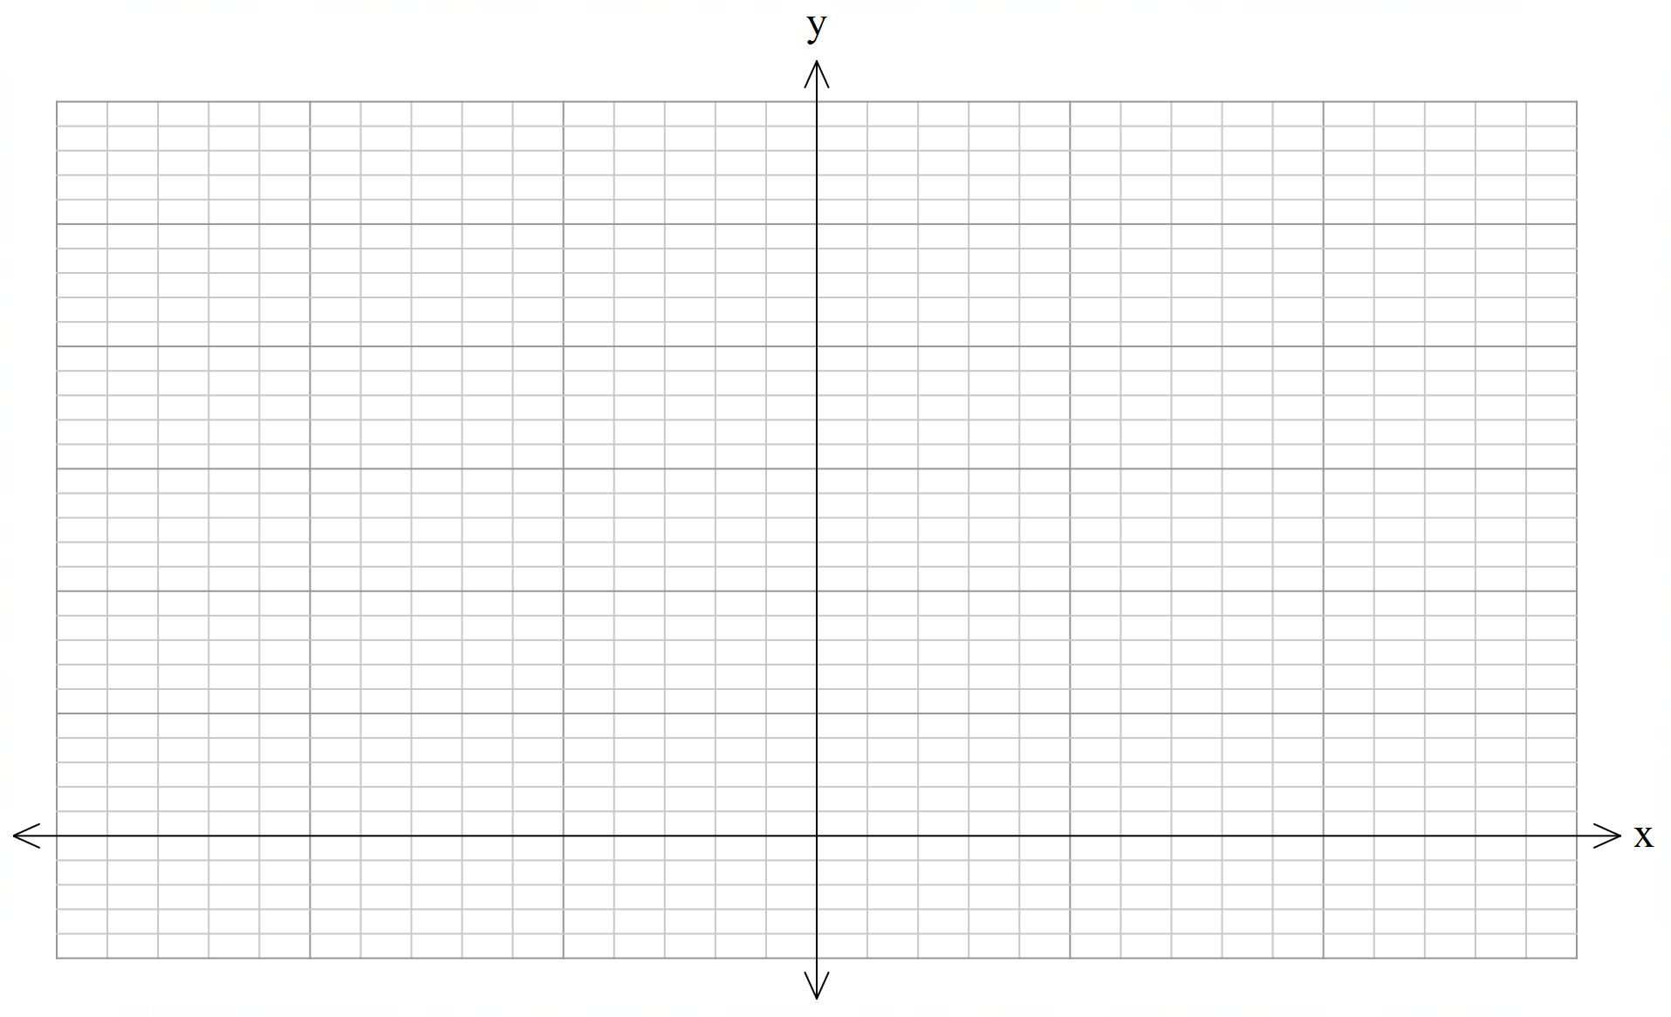
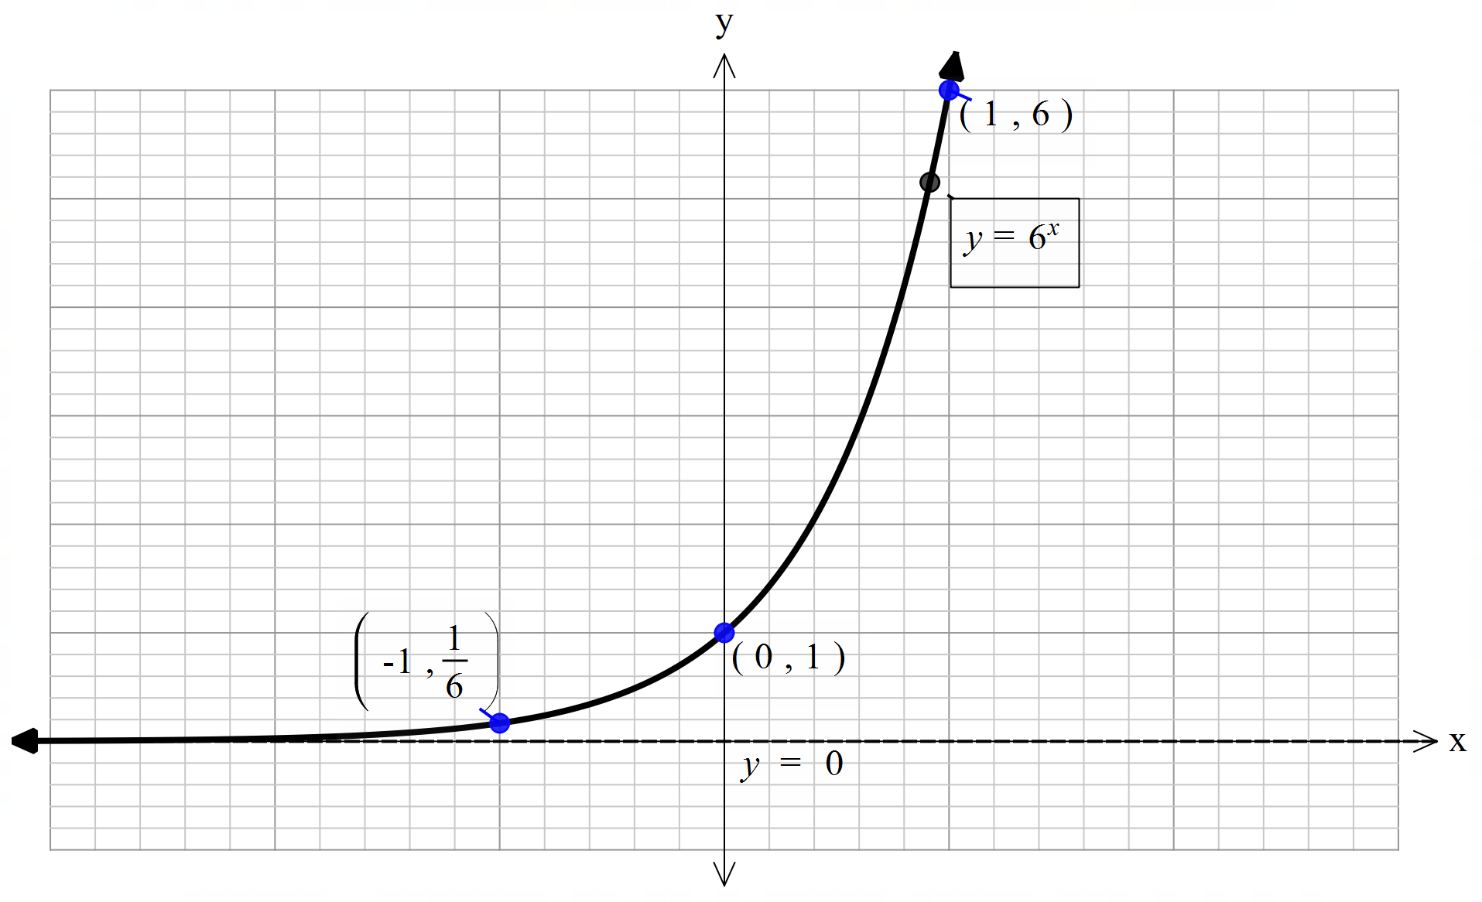
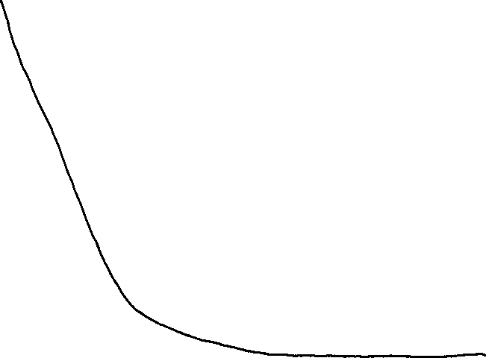

Guided Practice
Sketch the graph $y=6^{−x}$

Slide 7
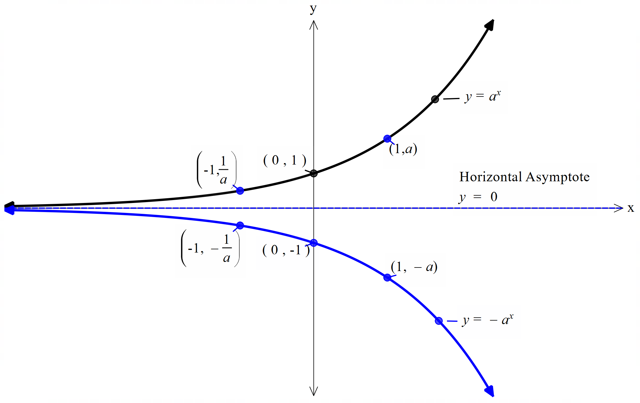
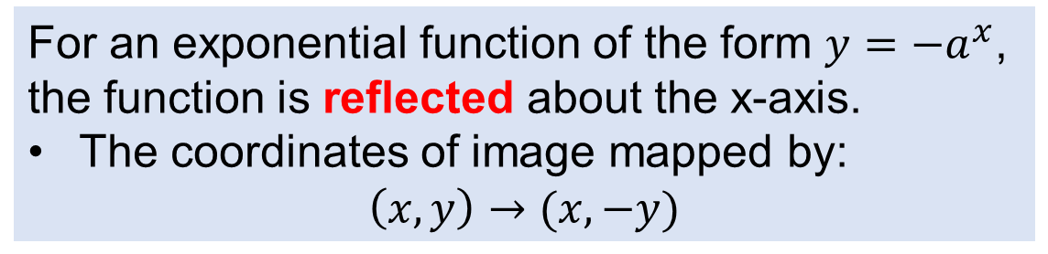
Activating Prior Knowledge - Reflection
For an exponential function of the form $y=−a^{x}$, the function is reflected about the x-axis.
The coordinates of image mapped by: $\left(x,y\right)→(x,−y)$

Slide 8
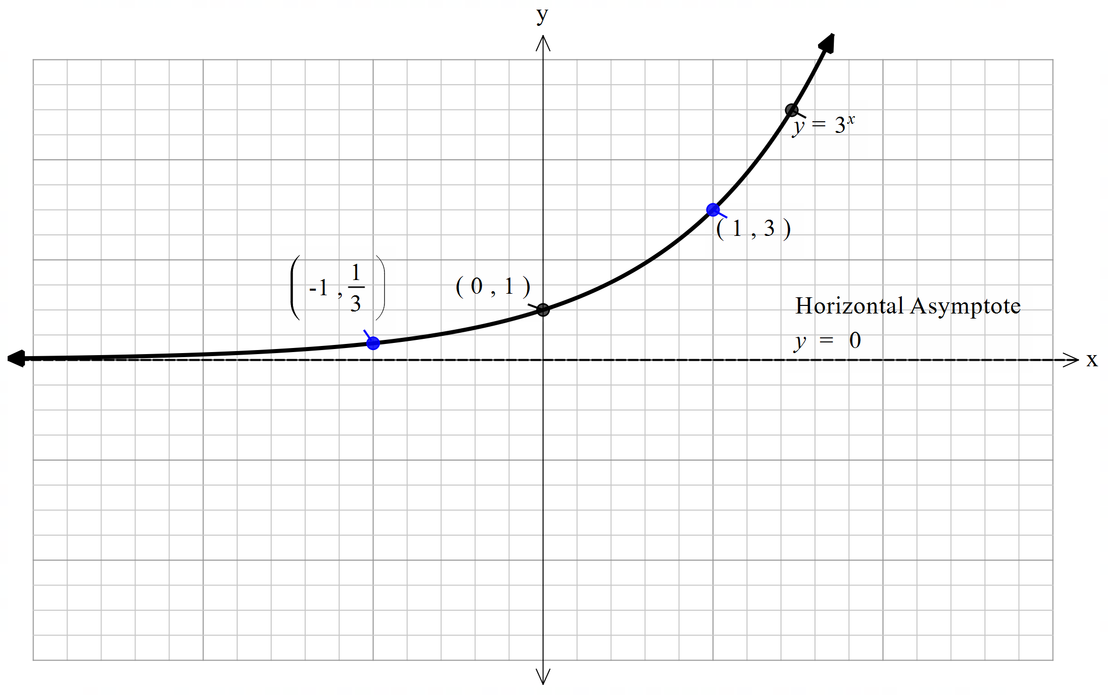
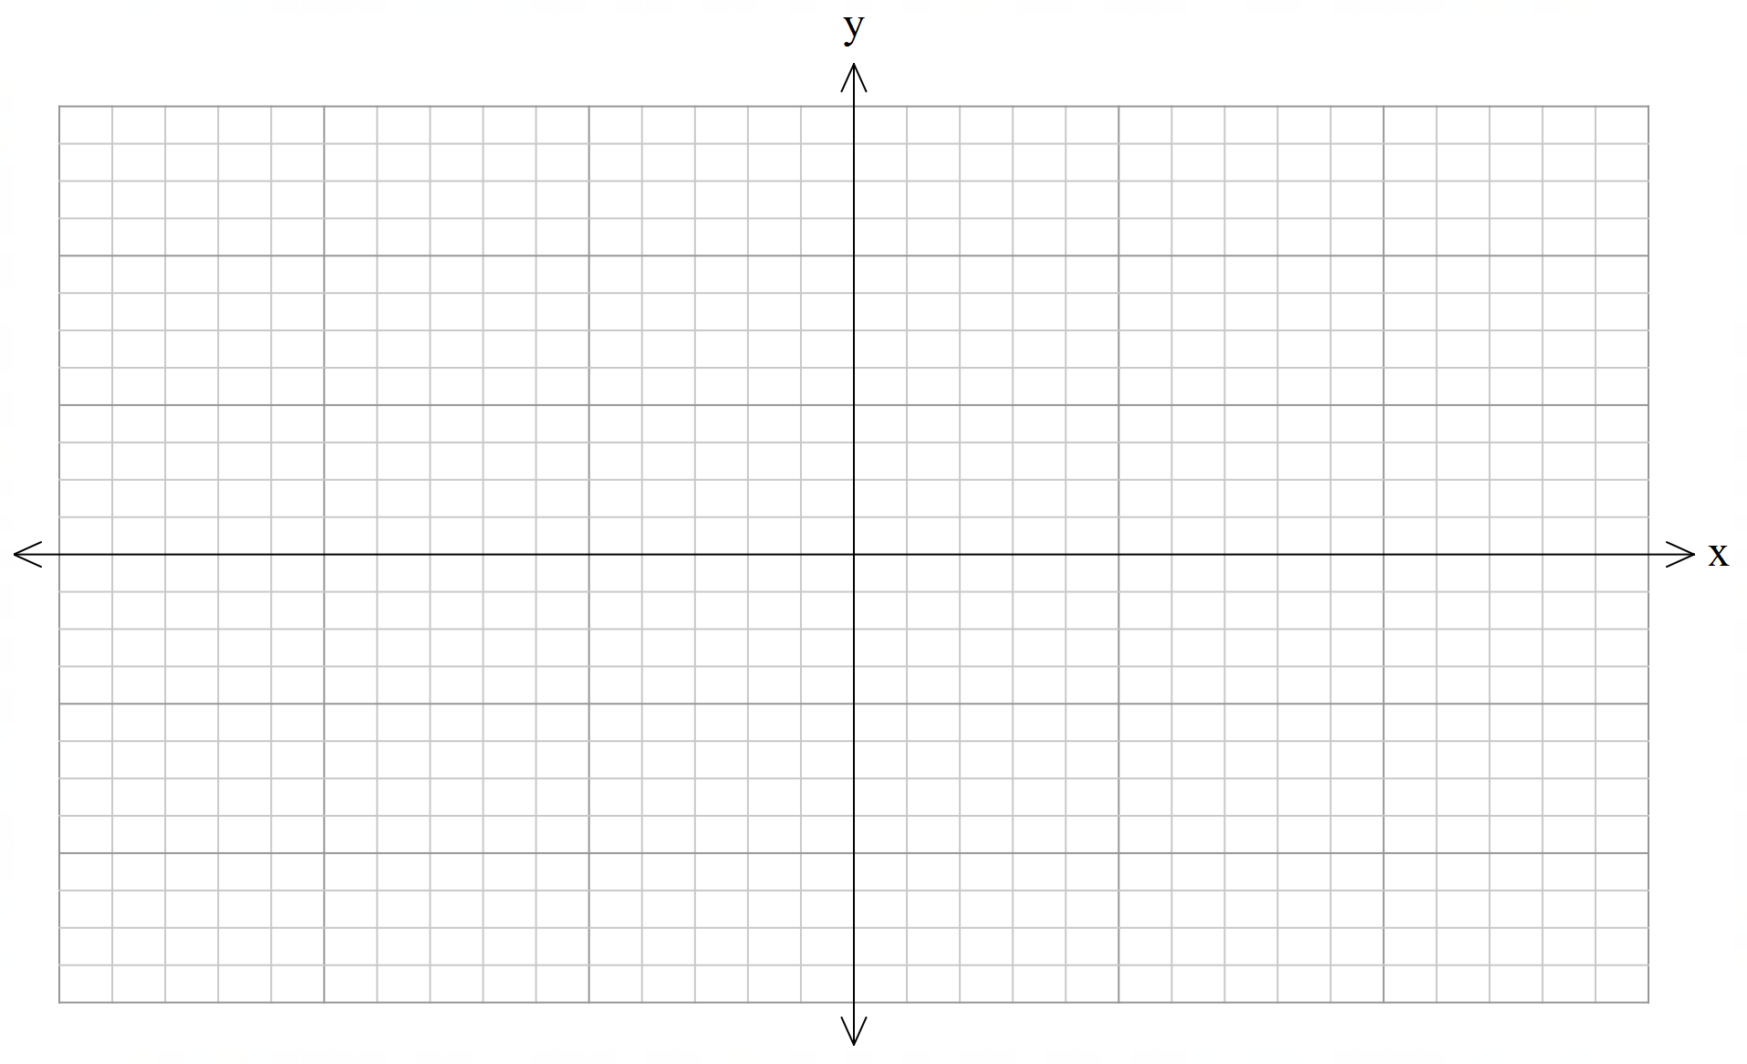
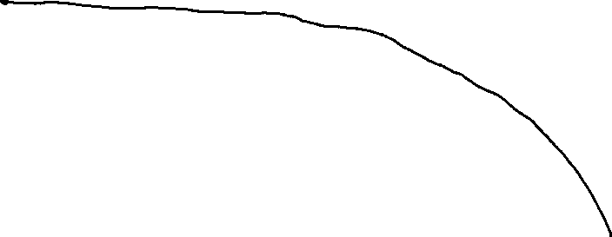
Guided Practice
Sketch the graph $y=−3^{x}$

Slide 9
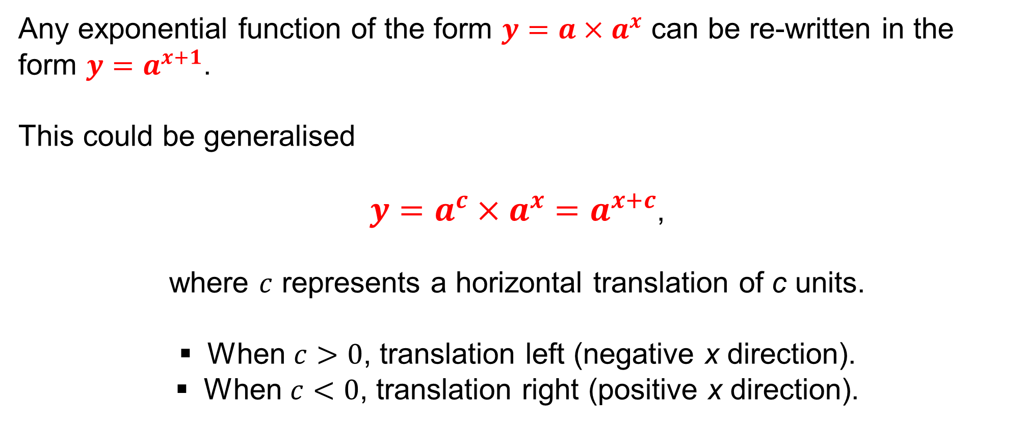
Activating Prior Knowledge - Translation
Any exponential function of the form $y=a×a^{x}$ can be re-written in the form $y=a^{x+1}$.
This could be generalised
$y=a^{c}×a^{x}=a^{x+c}$,
where $c$ represents a horizontal translation of c units.
When $c>0$, translation left (negative x direction).
When $c<0$, translation right (positive x direction).

Slide 10
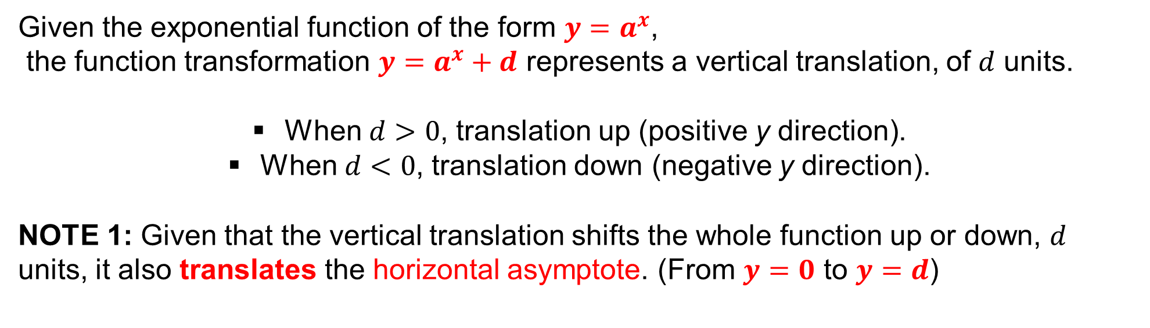
Activating Prior Knowledge - Translation
Given the exponential function of the form $y=a^{x}$, the function transformation $y=a^{x}+d$ represents a vertical translation, of $d$ units.
When $d>0$, translation up (positive y direction).
When $d<0$, translation down (negative y direction).
NOTE 1: Given that the vertical translation shifts the whole function up or down, $d$ units, it also translates the horizontal asymptote. (From $y=0$ to $y=d$)

Slide 11
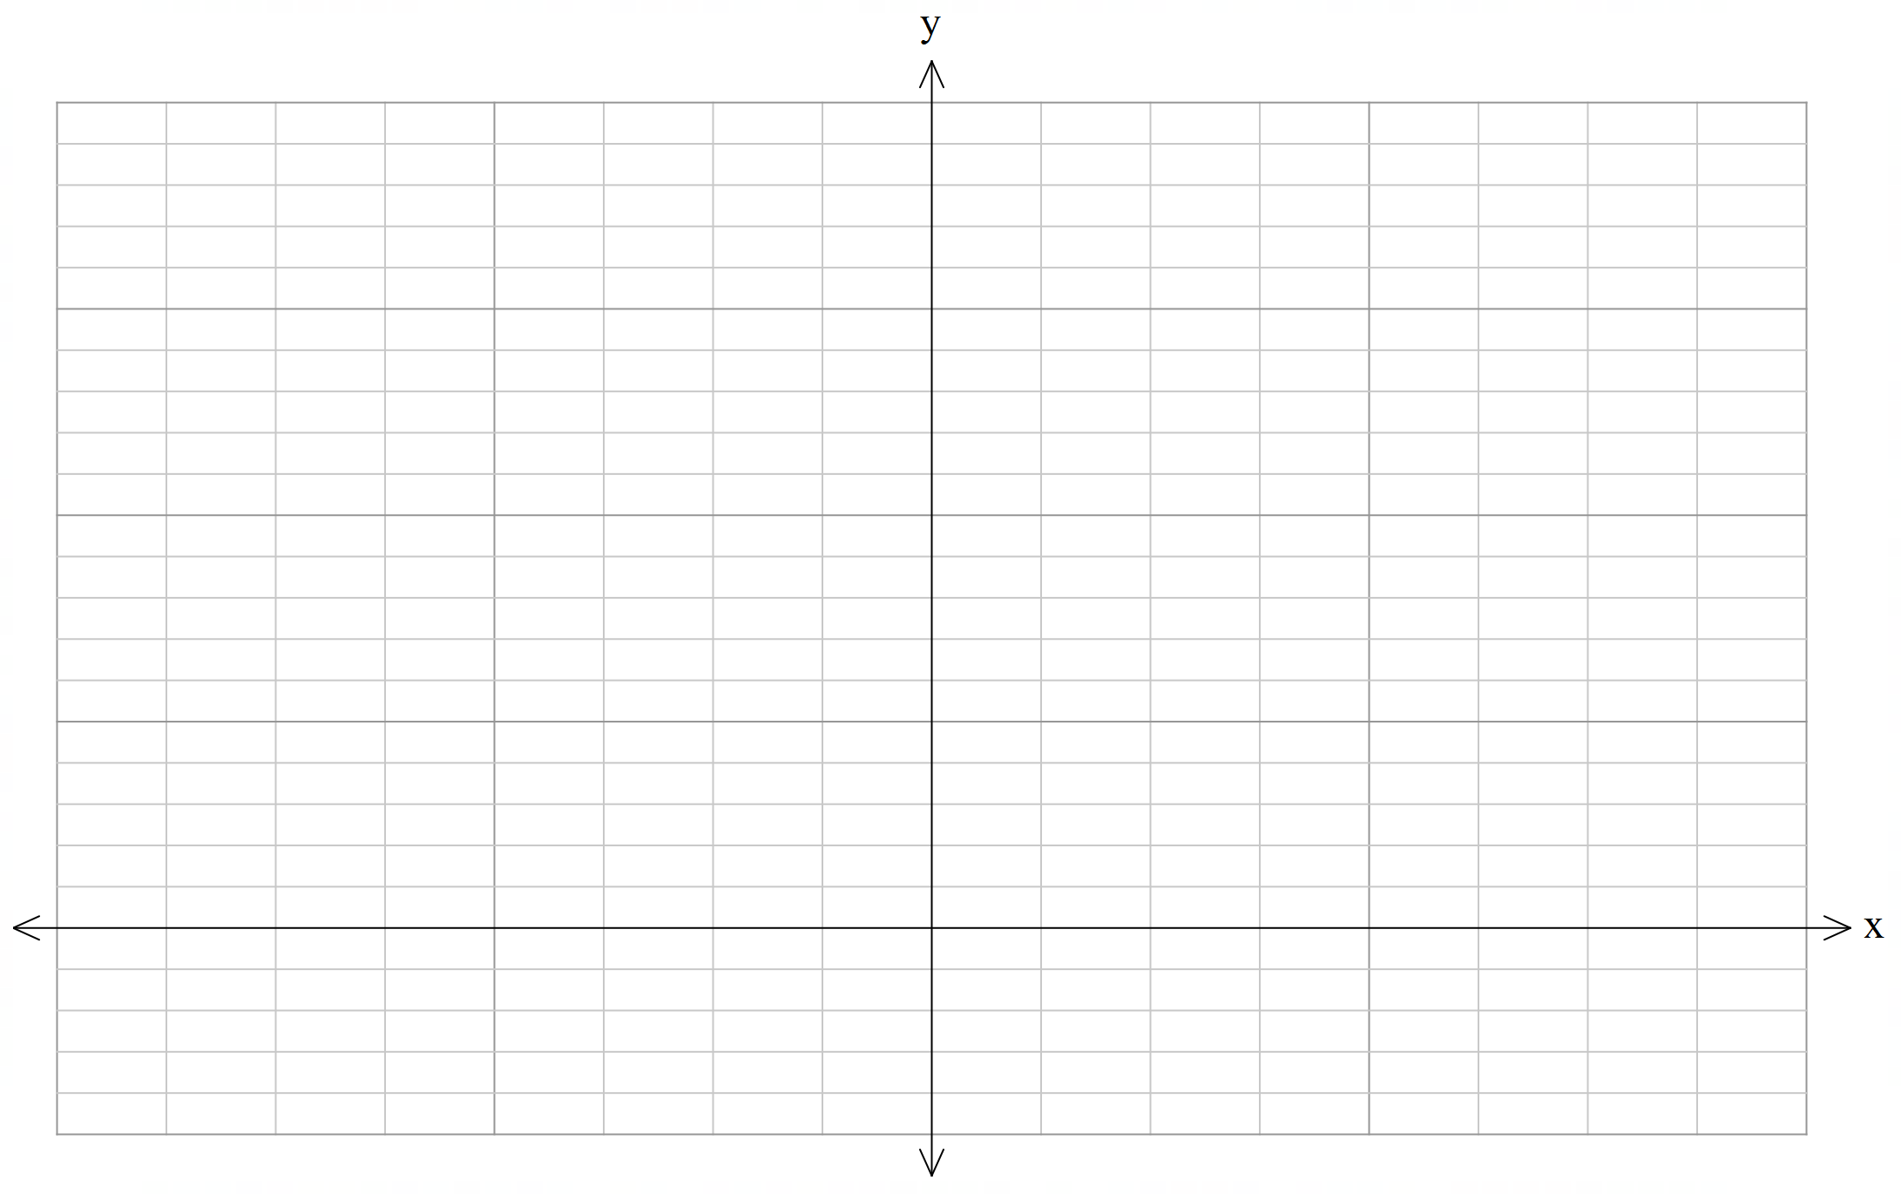
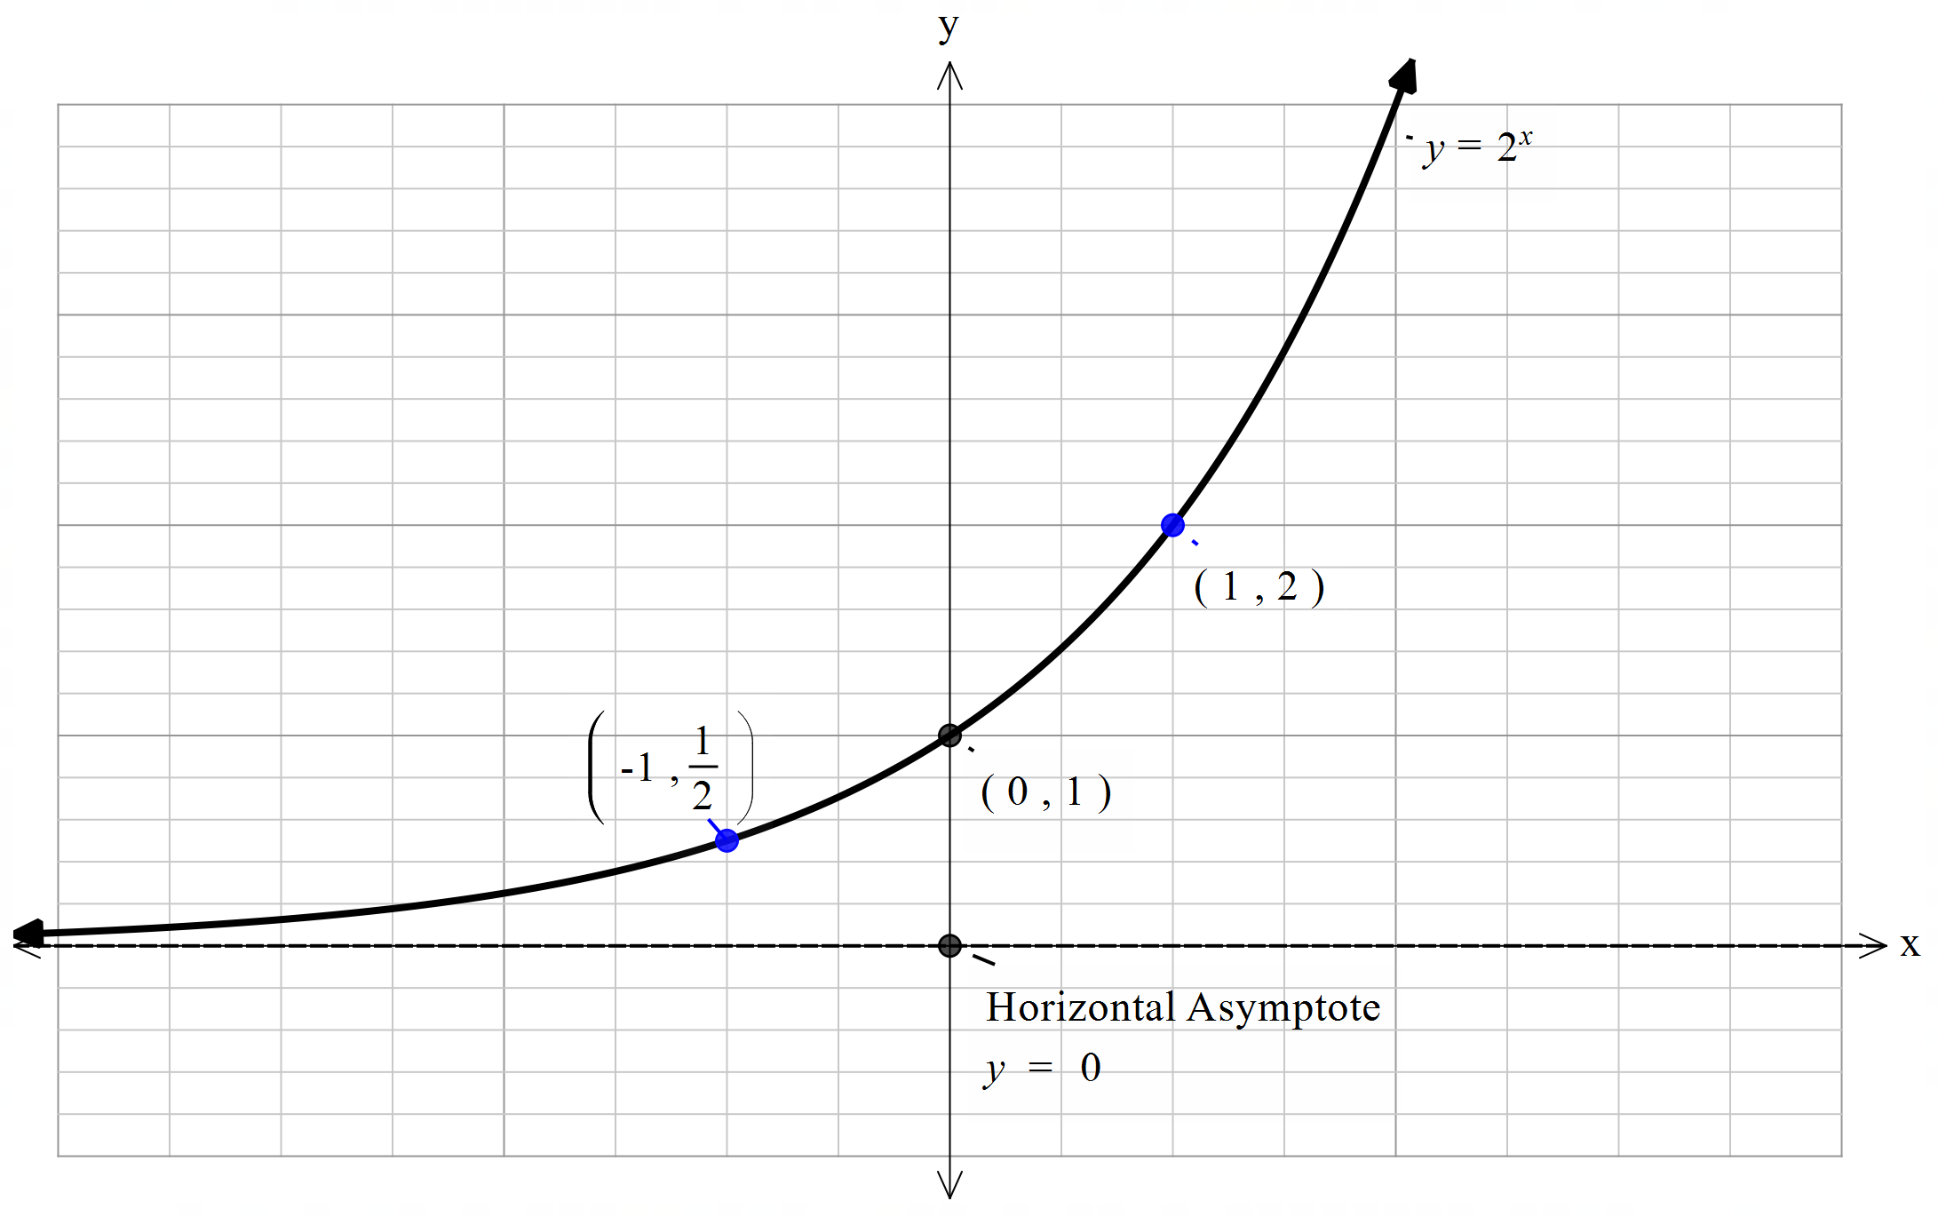
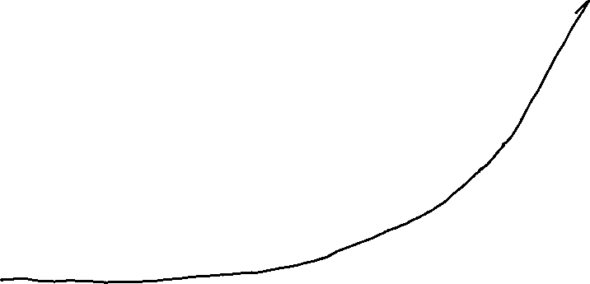

Guided Practice
Sketch the graph and state the range of $y=2^{x−1}+2$

Slide 12
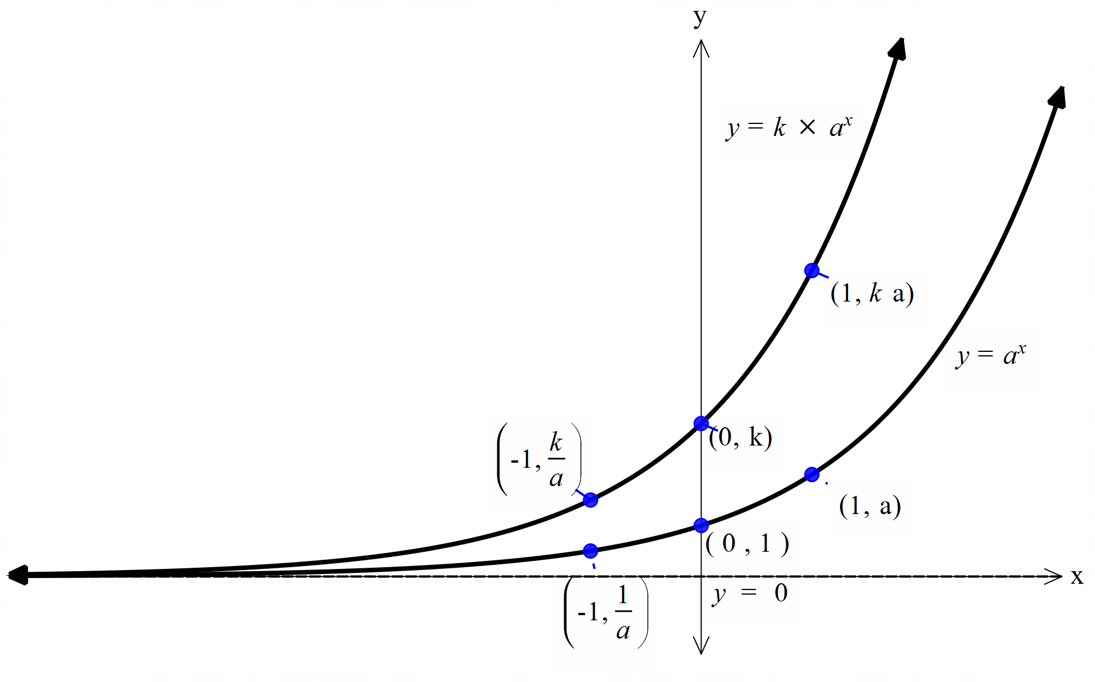
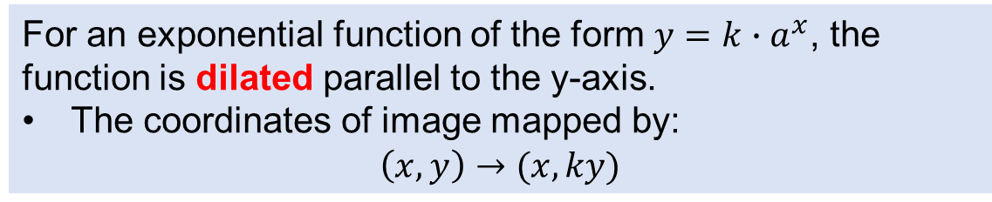
Activating Prior Knowledge - Dilation
For an exponential function of the form $y=k∙a^{x}$, the function is dilated parallel to the y-axis.
The coordinates of image mapped by: $\left(x,y\right)→(x,ky)$

Slide 13
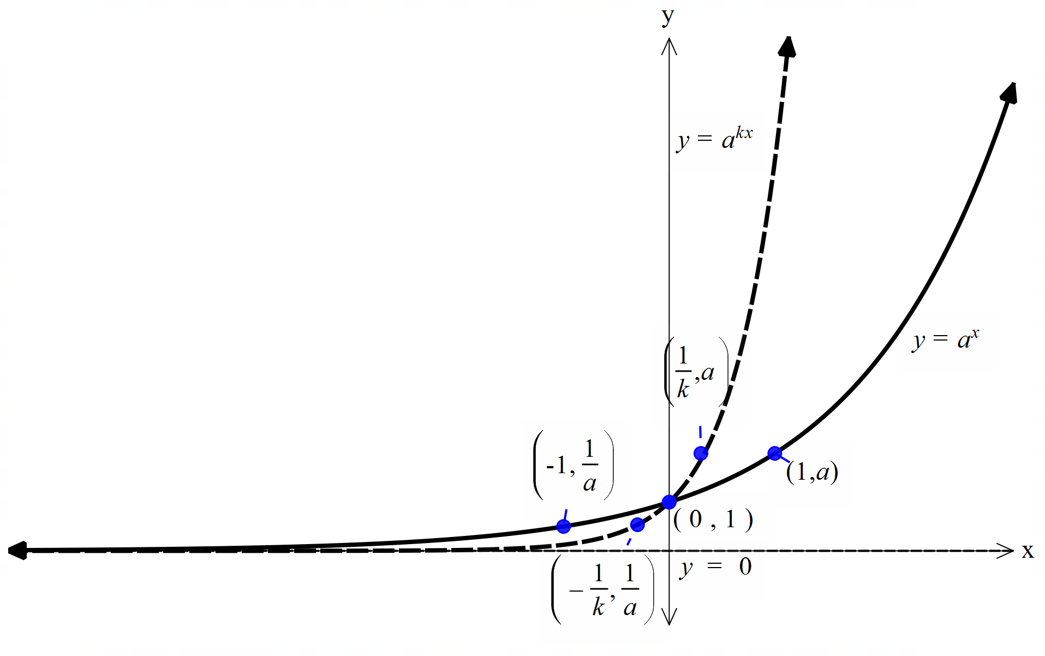
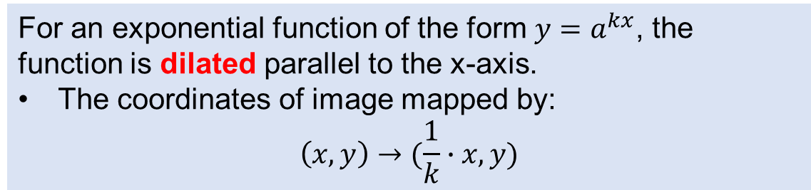
Activating Prior Knowledge - Dilation
For an exponential function of the form $y=a^{kx}$, the function is dilated parallel to the x-axis.
The coordinates of image mapped by: $\left(x,y\right)→(\frac{1}{k}∙x,y)$

Slide 14
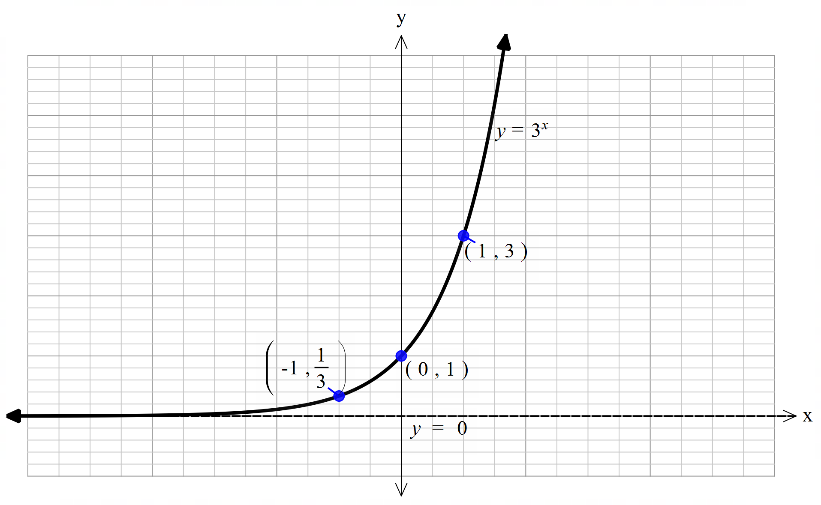
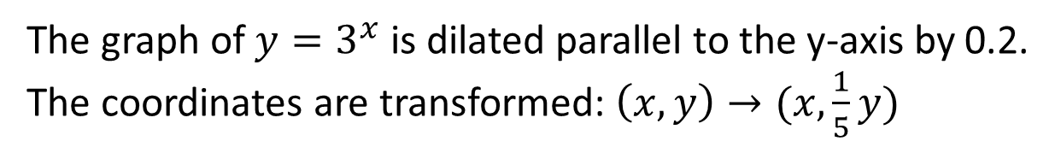
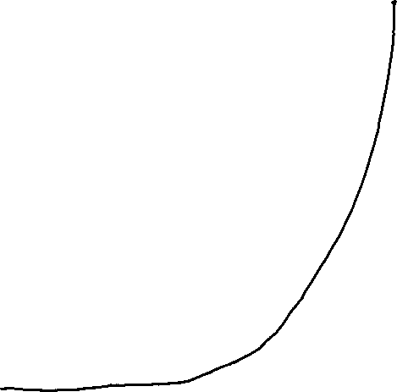
Guided Practice
The graph of $y=3^{x}$ is dilated parallel to the y-axis by 0.2.
The coordinates are transformed: $\left(x,y\right)→(x,\frac{1}{5}y)$
Sketch the graph $y={0.2×3}^{x}$

Slide 15
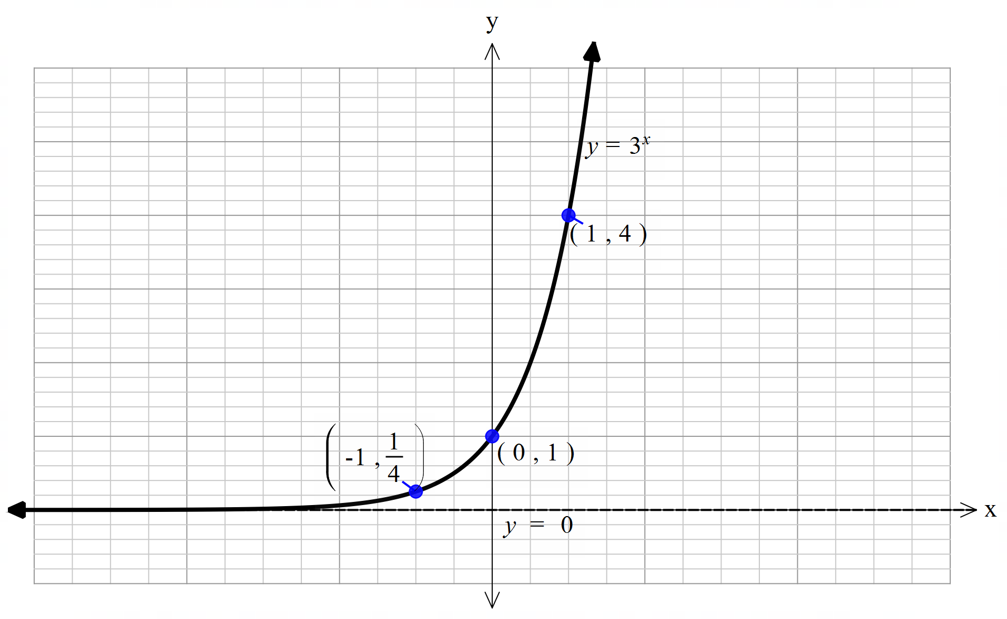
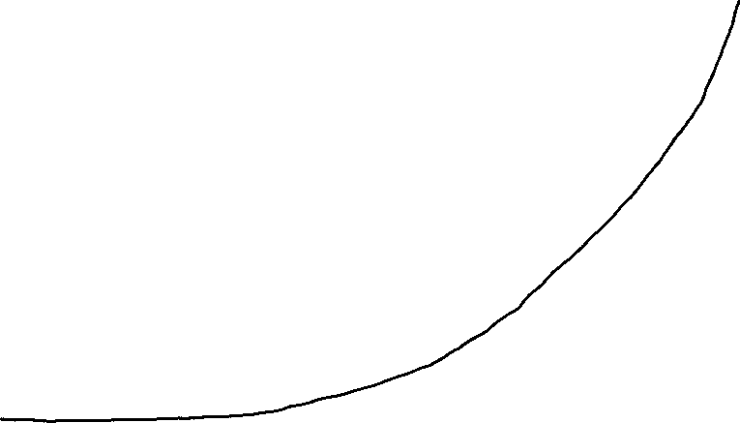
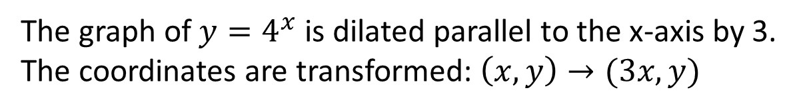
Guided Practice
The graph of $y=4^{x}$ is dilated parallel to the x-axis by 3.
The coordinates are transformed: $\left(x,y\right)→(3x, y)$
Sketch the graph $y=4^{\frac{x}{3}}$

Slide 16
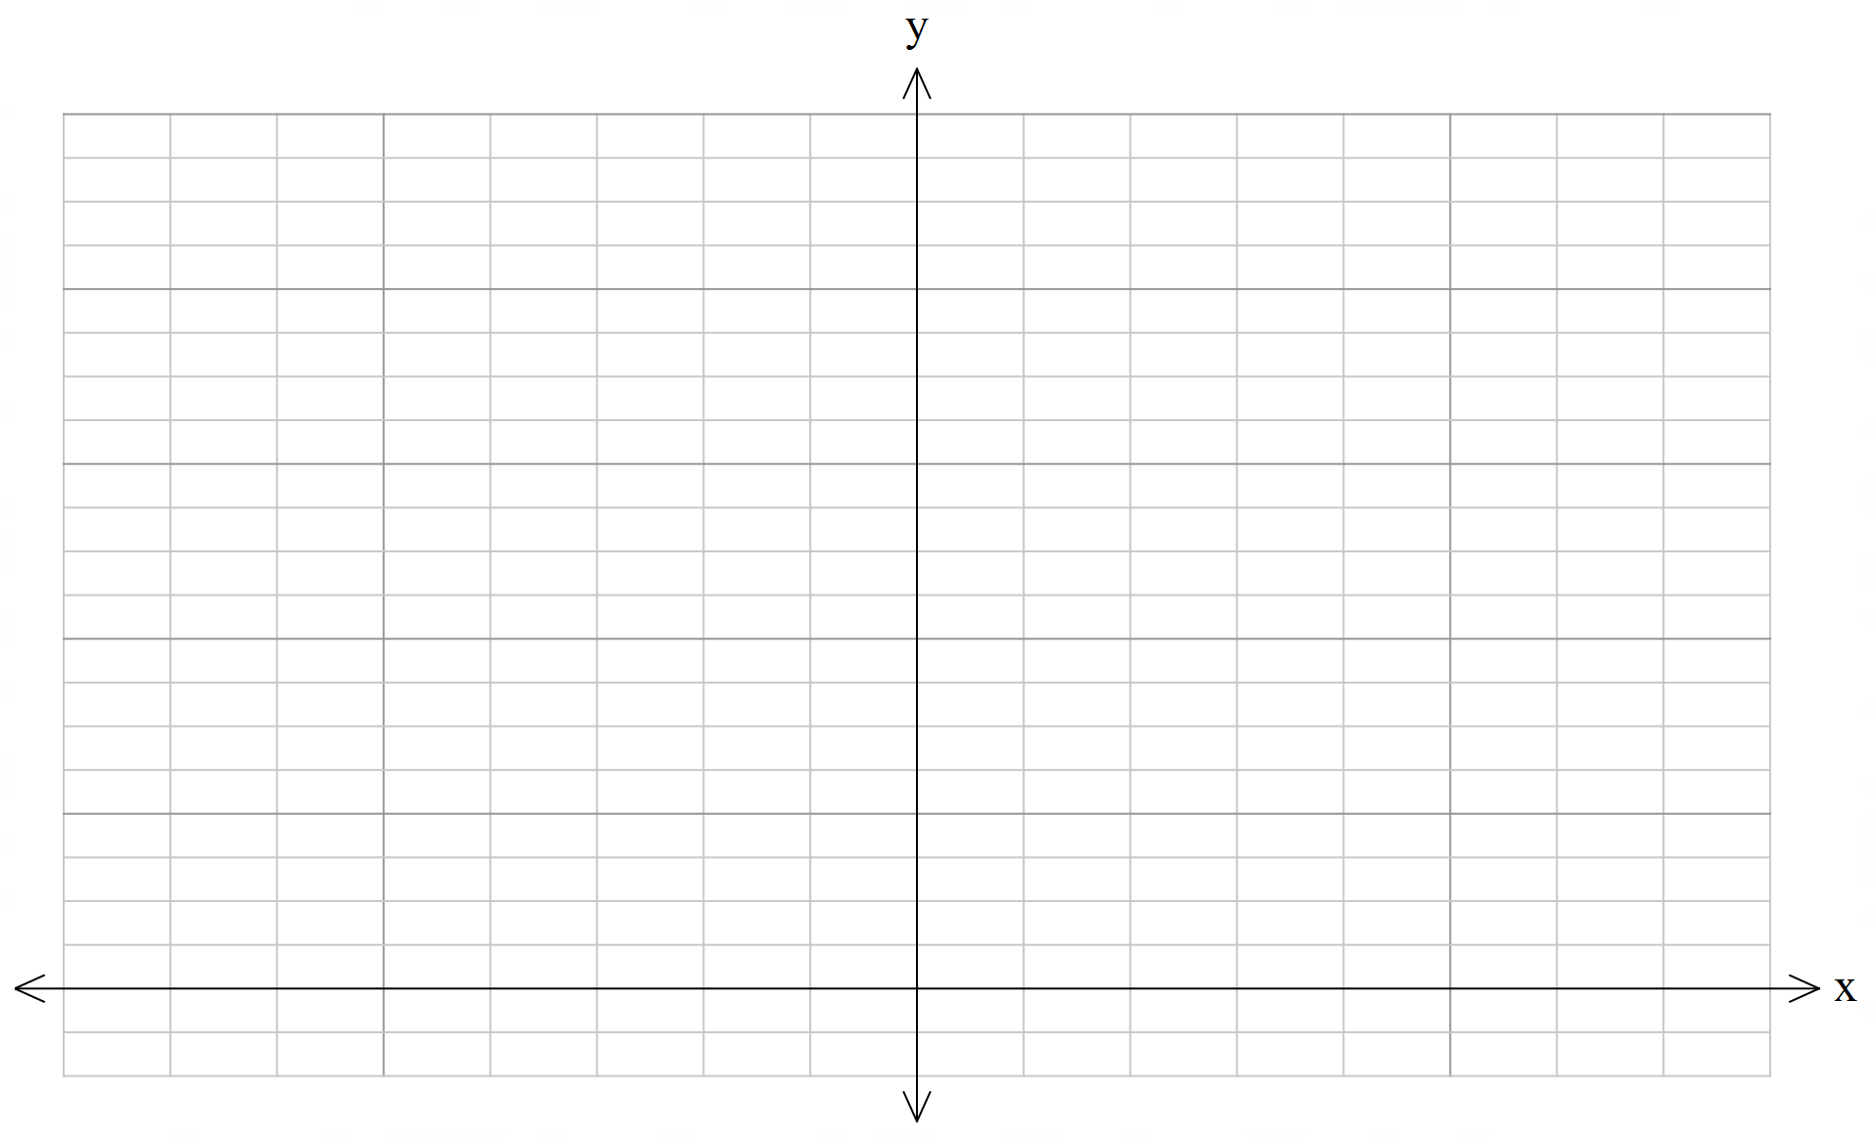
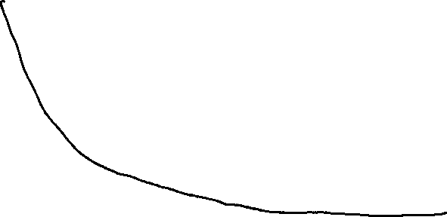


Guided Practice
Sketch the graph and state the range $y=2^{−x}+3$
The graph of $y=2^{x}$ is reflected about the y-axis and translated vertically up by 3 units.
The coordinates are transformed: $\left(x,y\right)→(−x, y+3)$
Range:$\{y∈ℝ, y>3\}$
$$y=3$$

Slide 17
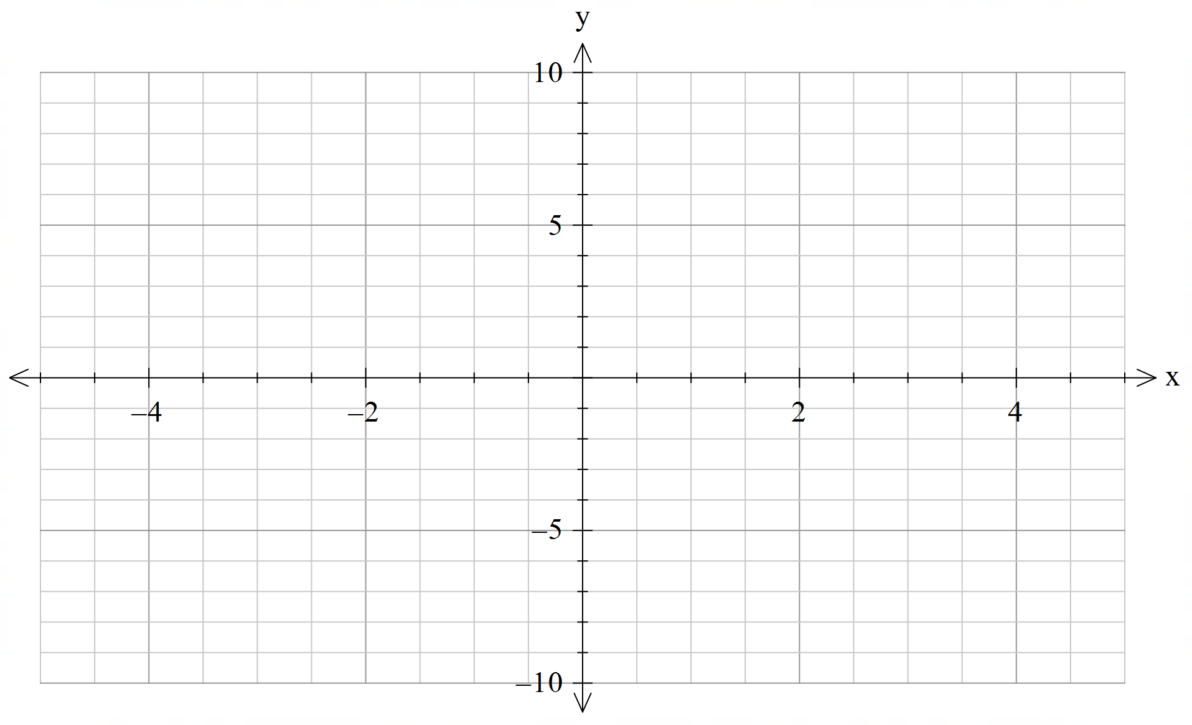

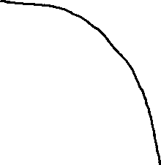




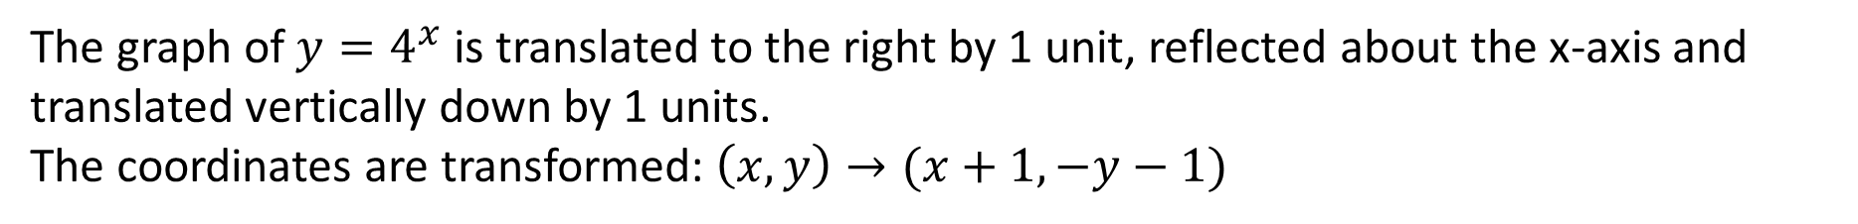

Guided Practice
Sketch the graph and state the range $y=−4^{x−1}−1$
The graph of $y=4^{x}$ is translated to the right by 1 unit, reflected about the x-axis and translated vertically down by 1 units.
The coordinates are transformed: $\left(x,y\right)→(x+1, −y−1)$
Range: $\{y∈ℝ:y<−1\}$
$$(0,−\frac{5}{4})$$
$$y=−1$$
$$(1,−2)$$
$$(2,−5)$$
$$y=−4^{x−1}−1$$

Slide 18
Independent Practice
Cambridge Ex 2A

